Slide 1
Bangladesh Anti-Discrimination Student Movement in 2024
Quota reform movement against anti-discrimination

Slide 2
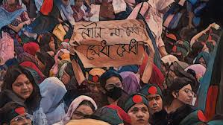
How and Why did the Bangladesh Anti-Discrimination Student Movement start?

Slide 3
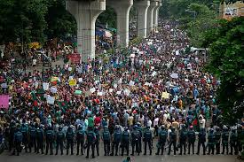
Committee Formation and Coordinators of the Quota Reform Movement

Slide 4
Coordinators of anti-discrimination student movements
Nahid Islam is a student of the Sociology department who is studying Master's, at Dhaka University.
Rifat Rashid is a student of the international relations department of Dhaka University.
Sarjis Alam is a student of the Botany Department.
Hasnat Abdullah is a student in the English Department.
Asif Mahmud is a student in the language Science department.
Abubakar Mazumder is a student of the geography department at Jahangirnagar University.
Arif Sohail is a student of the International Relations Department at Dhaka University.
Abu Saeed is a student of Rangpur Rokeya University "English

Slide 5
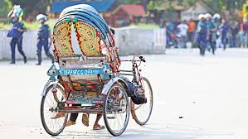

Student Movement's Nine-point Demand and Complete Shutdown Program.

